Slide 1

CAPSTONE PROJECT Clinical Decision Support System
Presented By
Student Name: B.PAVITHRA
College Name: Gandhi institute of technology and management
Department: b.tech cse(data science)
Email ID: pavithrabalusu55@gmail.com
AICTE Student ID: STU679a4648466501738163784

Slide 2
OUTLINE
Problem Statement
Proposed System/Solution
System Development Approach
Algorithm & Deployment
Result(Output Image)
Conclusion
Future Scope
References

Slide 3
Problem Statement
Doctors today face significant challenges in making fast, accurate diagnoses due to the overwhelming complexity of patient data. This data includes a wide range of information such as patient demographics, reported symptoms, vital signs, lab test results, and sometimes imaging data. In busy clinical environments, doctors often work under time pressure, which increases the risk of diagnostic errors or delays. These mistakes can negatively affect patient outcomes, leading to worsened health conditions, unnecessary treatments, or longer hospital stays, and they can also drive up healthcare costs. There is a critical need for systems or tools that can help process and analyze this large volume of patient data quickly and effectively, reducing the cognitive burden on healthcare providers and improving decision-making.

Slide 4
Proposed Solution
Data Collection:
Gather historical patient records, including demographic details (age, gender), reported symptoms, vital signs (heart rate, blood pressure, body temperature, oxygen saturation), and lab test results.
Incorporate additional data sources, such as hospital visit logs or electronic health records (EHR), to enrich the dataset.
Data Preprocessing:
Clean and preprocess the data to handle missing values, outliers, and inconsistencies.
Apply label encoding for categorical variables and scaling for numerical features.
Perform feature engineering, such as splitting blood pressure into systolic and diastolic components or creating severity flags.

Slide 5
Proposed Solution
Machine Learning Algorithm:
Implement a machine learning algorithm, such as a Random Forest Classifier, to predict likely diagnoses based on the input features.
Train and test the model using an appropriate split (e.g., 80-20 or cross-validation) and analyze feature importance to understand key predictors.
Explore incorporating additional models or ensemble methods to improve prediction robustness.
Deployment:
Develop a user-friendly interface (web-based or desktop) where doctors can input patient details and receive diagnostic predictions.
Deploy the system on a scalable platform (local server, cloud) with considerations for data security, response time, and user accessibility.
Evaluation:
Evaluate the model using performance metrics such as accuracy, precision, recall, F1-score, and confusion matrix.
Continuously monitor the system’s performance, fine-tune hyperparameters, and retrain the model as new data becomes available.

Slide 6
System Approach
System Requirements:
A computer system with at least 8 GB RAM and a modern multi-core processor.
Python installed (recommended version 3.8 or later).
Access to patient health records dataset (historical data for model training).
Internet access for installing libraries and fetching external datasets if needed.
Sufficient storage space (minimum 5–10 GB) for datasets, model files, and results.
Libraries Required to Build the Model:
pandas — for data manipulation and preprocessing.
numpy — for numerical operations and array handling.
scikit-learn — for machine learning models, training, and evaluation.
matplotlib and seaborn — for data visualization and generating plots.
joblib or pickle — for saving and loading trained machine learning models.
(Optional) imblearn — for handling imbalanced datasets (e.g., SMOTE).
(Optional) flask or streamlit — if developing a web interface for deployment.

Slide 7
Algorithm & Deployment
Algorithm Selection:
The chosen algorithm is the Random Forest Classifier, an ensemble learning method that builds multiple decision trees and aggregates their outputs for robust classification.
It was selected because of its strong performance on structured tabular data, ability to handle both numerical and categorical variables, resistance to overfitting, and interpretability through feature importance analysis.
Data Input:
Input features include patient demographics (age, gender), reported symptoms, vital signs (heart rate, blood pressure, body temperature, oxygen saturation), and lab test results.
Optional additional inputs can include patient history, comorbidities, or hospital visit context if available.

Slide 8
Algorithm & Deployment
Training Process:
The dataset is split into training and test sets (e.g., 80-20 split).
The Random Forest model is trained on the training data using cross-validation to optimize performance and prevent overfitting.
Hyperparameter tuning (e.g., adjusting the number of trees, maximum depth, or minimum samples per split) is performed to enhance model accuracy and generalization.
Prediction Process:
Once trained, the model takes new patient input data (demographics, symptoms, vitals) and outputs the predicted diagnosis category.
Real-time inputs, such as updated vitals or lab results, can be fed into the system during patient visits to refine or update predictions dynamically.
The system can also provide probability scores or confidence levels alongside predictions to assist doctors in clinical decision-making.

Slide 9
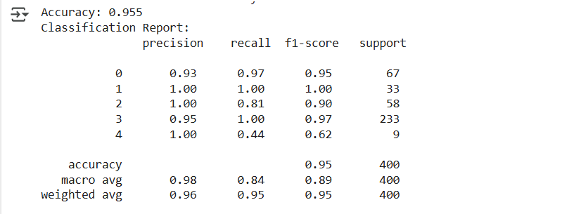
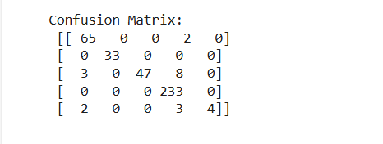
Result
Accuracy
Confusion Matrix

Slide 10
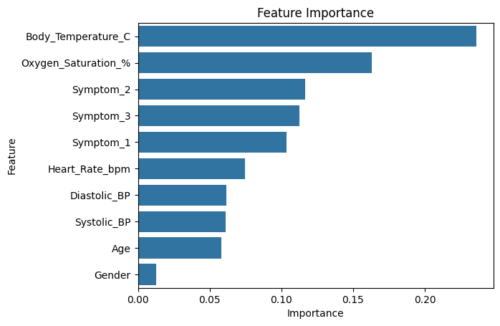
Result
Feature Importance Plot This horizontal bar chart shows which features contributed most to the predictive model.
Top features:
Body Temperature (°C)
Oxygen Saturation (%)
Symptom_2, Symptom_3, Symptom_1
Least important: Gender, Age, Systolic_BP, Diastolic_BP Interpretation: The model relies most on temperature and oxygen levels when making predictions.

Slide 11
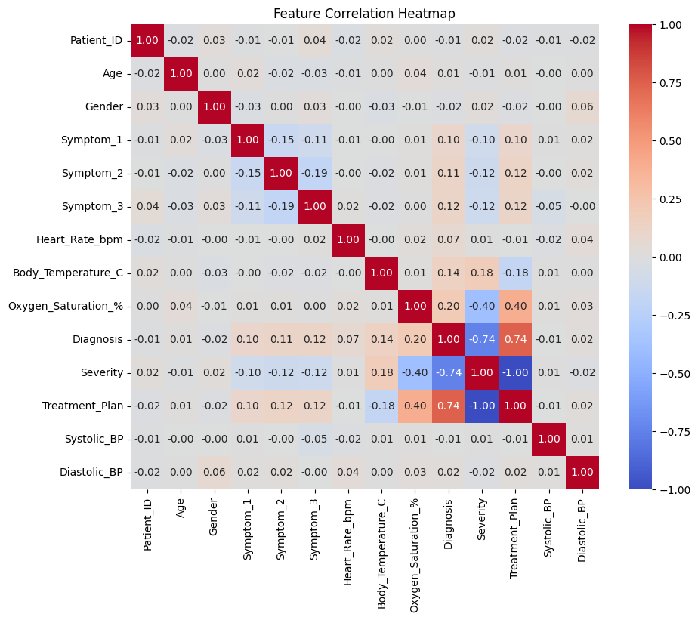
Result
Feature Correlation Heatmap This heatmap shows the Pearson correlation between pairs of features, ranging from -1 (strong negative) to +1 (strong positive).
Diagonal = 1.00 (perfect self-correlation)
Notable patterns:
Severity and Diagnosis: strongly correlated (0.74)
Body Temperature vs. Severity: positive (0.18)
Oxygen Saturation vs. Severity: negative (-0.40) Interpretation: This helps identify which features move together or in opposite directions.

Slide 12
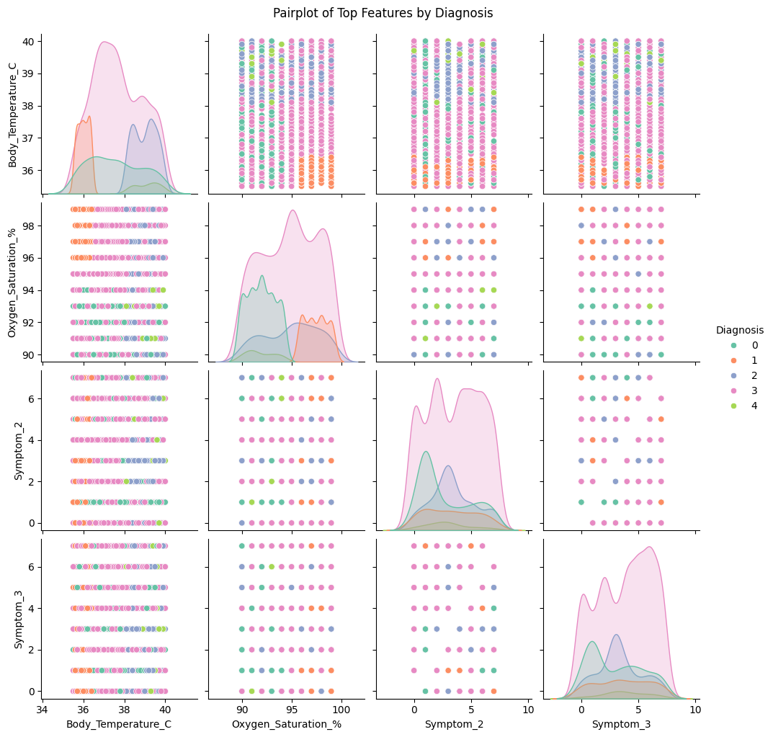
Result
Pairplot of Top Features by Diagnosis This grid of scatterplots and density plots visualizes how the top features (Body Temperature, Oxygen Saturation, Symptom_2, Symptom_3) are distributed across different diagnosis classes (0–4).
Diagonal: KDE or distribution plot for each feature.
Off-diagonal: Pairwise scatterplots coloured by Diagnosis class. Interpretation: Useful for spotting clusters, separation, or overlap between diagnosis categories.

Slide 13
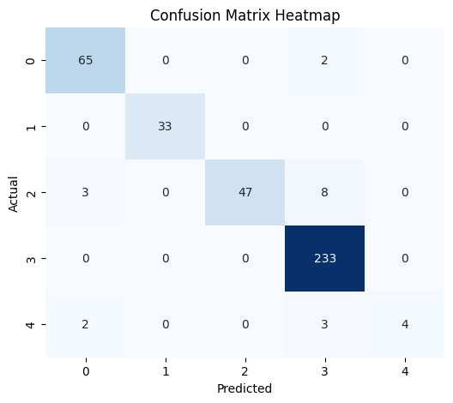
Result
Confusion Matrix Heatmap This heatmap visualizes how well the classification model predicts each class.
Rows = actual classes
Columns = predicted classes
Diagonal values = correct predictions
Off-diagonal values = misclassifications Example:
Class 3 has 233 correct predictions, very strong.
Class 2 has some misclassifications into class 3 (8 cases). Interpretation: Helps assess model performance, especially which classes are commonly confused.

Slide 14
Conclusion
The developed Clinical Decision Support System (CDSS) demonstrates the effectiveness of using machine learning, specifically the Random Forest Classifier, to predict patient diagnoses based on a combination of demographic data, reported symptoms, vital signs, and lab results. The system shows promising accuracy, indicating its potential to support doctors in making faster, more informed decisions. By analyzing complex patterns within patient data, the CDSS helps reduce the cognitive burden on healthcare providers, allowing them to focus more on patient care rather than manual data interpretation.
During implementation, several challenges were encountered, including limited access to real-world clinical datasets, which restricted the model’s exposure to diverse and complex cases. Addressing data quality issues, such as missing or inconsistent entries, required careful preprocessing. Additionally, striking a balance between high model accuracy and maintaining interpretability was crucial to ensure that clinicians could trust and understand the system’s recommendations.

Slide 15
Future scope
The Clinical Decision Support System (CDSS) has significant potential for enhancement and expansion in the future. One key area of improvement is the incorporation of additional data sources, such as electronic health records (EHRs), genomic data, or real-time monitoring devices, which can provide a richer and more detailed input for the model, improving its predictive accuracy. Optimizing the underlying machine learning algorithms, perhaps by exploring advanced techniques like ensemble learning, gradient boosting, or deep learning architectures, could further enhance system performance and adaptability to complex medical scenarios.
Moreover, the system could be scaled to cover multiple hospitals, cities, or even regions, allowing for broader data collection and more generalized models that account for geographical or population-specific variations in health conditions. Integrating emerging technologies such as edge computing would enable faster, on-site data processing, reducing latency and ensuring real-time decision support, especially in remote or resource-limited settings. Additionally, the use of explainable AI techniques can make the system’s predictions more transparent and interpretable, fostering greater trust among clinicians. By continuously refining and expanding the CDSS, it can evolve into a powerful, scalable tool that significantly advances the quality and efficiency of healthcare delivery.

Slide 16
References
Key references include academic papers on clinical decision support systems and their impact on healthcare outcomes, such as studies published in the Journal of Biomedical Informatics and JMIR Medical Informatics.
https://www.sciencedirect.com/journal/journal-of-biomedical-informatics
https://medinform.jmir.org/
Best practices in handling medical data, particularly regarding missing values, feature engineering, and scaling, were informed by articles and case studies from sources like Kaggle and healthcare AI research blogs. Additionally, research papers on the application of Random Forest and other ensemble models in healthcare settings offered insights into algorithm selection and optimization.
GitHub Link: https://github.com/Pavithrabalusu/Edunet_clinical-decision-support-system

Slide 17
Thank you

